Slide 1
Laudato Si, Stewardship & Social Justice Kia Kororiatia, kaitiakitanga me te tika
Reflecting on ‘Laudato Si’
in the Context of God-Te Atua-Io Matua Kore
strand
Catholic Schools Office, Diocese of Auckland, New Zealand

Slide 2
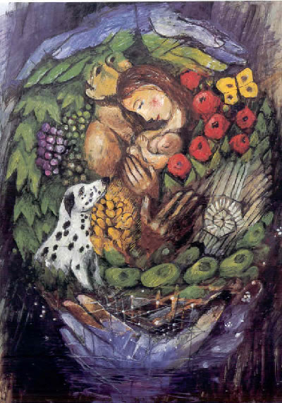
BEGINNING PRAYER:
A Prayer for our Earth
All-powerful God, you are present in the whole universe
and in the smallest of your creatures.
You embrace with your tenderness all that exists.
Pour out upon us the power of your love,
that we may protect life and beauty.
Fill us with peace, that we may live as brothers and sisters, harming no one. Amen
- Pope Francis

Slide 3
In preparation for this session teachers have had the opportunity to read the following: 1. paragraphs 65, 66, 67 and 69 of Laudato Si , 2. the Theological Focus GOD-TE ATUA-IO MATUA KORE, 3. Achievement objectives Y1-8 for the strand (These were included as resources with this powerpoint.)
Catholic Schools Office, Diocese of Auckland, New Zealand

Slide 4
Watch the video then take a minute in silent reflection...

Slide 5
Read Paragraph 65 Laudato Si
65. In the first creation account in the Book of Genesis, God’s plan includes creating humanity. After the creation of man and woman, “God saw everything that he had made, and behold it was very good” (Gen 1:31)…..How wonderful is the certainty that each human life is not adrift in the midst of hopeless chaos, in a world ruled by pure chance or endlessly recurring cycles! The Creator can say to each one of us: “Before I formed you in the womb, I knew you” (Jer 1:5). Each of us is willed, each of us is loved, each of us is necessary”.
AA6 Year 1 AO1, AA6 Year 3 AO 1, AA4, Y5 AO1, AA5, Yr 7 AO1

Slide 6
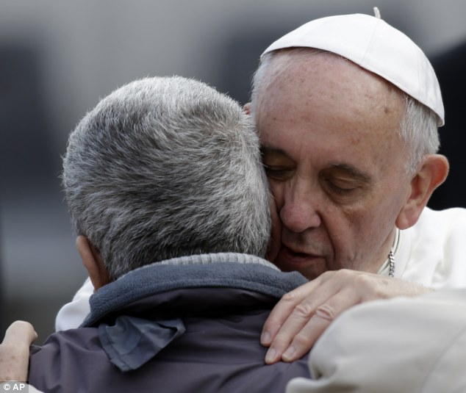
Share with someone beside you:
What does it feel like to be
“willed...
...loved ...
...necessary...”?
What does it say to us about each other?
(3 minutes)

Slide 7
Read Paragraph 66
66. ..’human life is grounded in three fundamental and closely intertwined relationships: with God, with our neighbour and with the earth itself. According to the Bible, these three vital relationships have been broken, both outwardly and within us…the harmony which Saint Francis of Assisi experienced with all creatures was seen as a healing of that rupture.This is a far cry from our situation today, where sin is manifest in all its destructive power in wars, the various forms of violence and abuse, the abandonment of the most vulnerable, and attacks on nature.
AA5 Year 1 AO2, AA6. Year 2, AO1; AA5 Year 4 AO 1, AA5, Y8 AO2, AA1. Yr6, AO1

Slide 8
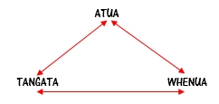
In groups of 3 or 4, discuss:
In Maori spirituality we speak of the intrinsic tapu and the relational tapu between Atua, tangata and whenua.
How does this relate to what Pope Francis is saying about human life?
Can you identify specific times and places (globally and in Aoteraoa New Zealand) where the harmony between the Creator, humanity and creation was/is being disrupted?
( 5 minutes)

Slide 9
The stories from Genesis bear witness to everything being interconnected.
Discuss the meaning of these words:
Fraternity / whakawhanaungatanga
Justice / pono
Faithfulness / tumanako
How do these words relate to a tikanga Maori approach to care for the environment?
How might they influence our relationships in Aotearoa?
(5 minutes)

Slide 10
Read Paragraph 67.
67. We are not God. The earth was here before us and it has been given to us….Although it is true that we Christians have at times incorrectly interpreted the Scriptures, nowadays we must forcefully reject the notion that our being created in God’s image and given dominion over the earth justifies absolute domination over other creatures…. Each community can take from the bounty of the earth whatever it needs for subsistence, but it also has the duty to protect the earth and to ensure its fruitfulness for coming generations. “The earth is the Lord’s” (Ps 24:1); to him belongs “the earth with all that is within it” (Dt 10:14).
CST Principle of Stewardship
AA2. Yr2, AO3; AA6. Yr 4, AO2, AA4, Yr 5, AO1; AA2. Yr 7, AO2

Slide 11
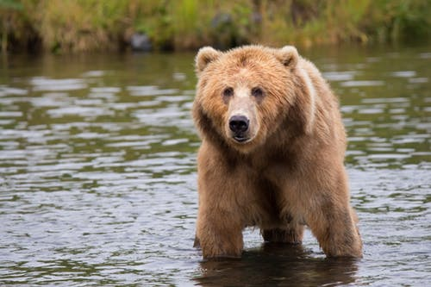
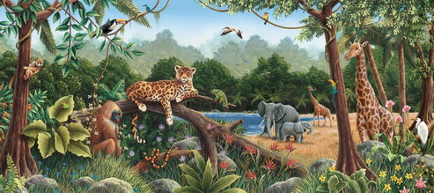
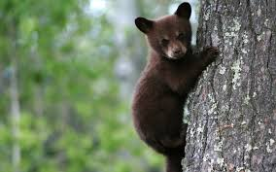
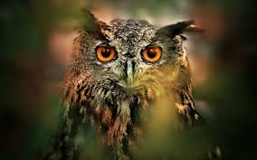
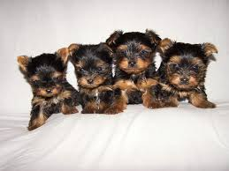
3 Minute Challenge:
How many animals can you name using the word anthropomorphism:
Clearly the Bible has no place for a tyrranical anthropocentrism unconcerned with other creatures.

Slide 12
Read Paragraph 69
69……we are called to recognize that other living beings have a value of their own in God’s eyes: “by their mere existence they bless him and give him glory”, and indeed, “the Lord rejoices in all his works” (Ps 104:31). By virtue of our unique dignity and our gift of intelligence, we are called to respect creation and its inherent laws, for “the Lord by wisdom founded the earth” (Prov 3:19)
Respect for Life
AA2. Yr 5, AO4; AA6. Yr 7, AO4

Slide 13
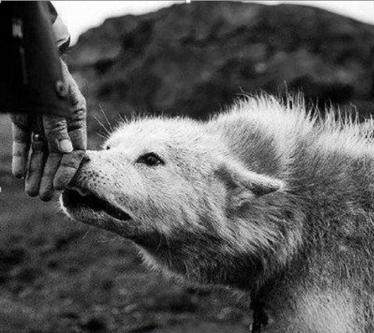
Share with someone beside you:
Is there a creature that you find especially “wonder-full’?
A bear? A kukupa? An elephant?
A frog? A yellow eyed penguin? A whale?
What attributes make this creature unique and amazing?
How does this particular creature reflect God’s wisdom and goodness?
(3 minutes)

Slide 14
ACTIVITY: Create a lesson(learning experience) for students based on one of the following aspects Laudato Si covered today: (5-10 mins)
1. Paragraph 65 or the Genesis account of Creation.
AA6 Year 1 AO1, AA6 Year 3 AO 1, AA4, Y5 AO1, AA5, Yr 7 AO1
2. Whakawhanaungatanga / right relationships
AA5 Year 1 AO2, AA6. Year 2, AO1; AA5 Year 4 AO 1, AA5, Y8 AO2, AA1. Yr6, AO1
3. kaitiakitanga/stewardship
CST Principle of Stewardship
AA2. Yr2, AO3; AA6. Yr 4, AO2, AA4, Yr 5, AO1; AA2. Yr 7, AO2
4. Te Tapu o te Ao / Respect for life.
Respect for Life: AA2. Yr 5, AO4; AA6. Yr 7, AO4

Slide 15
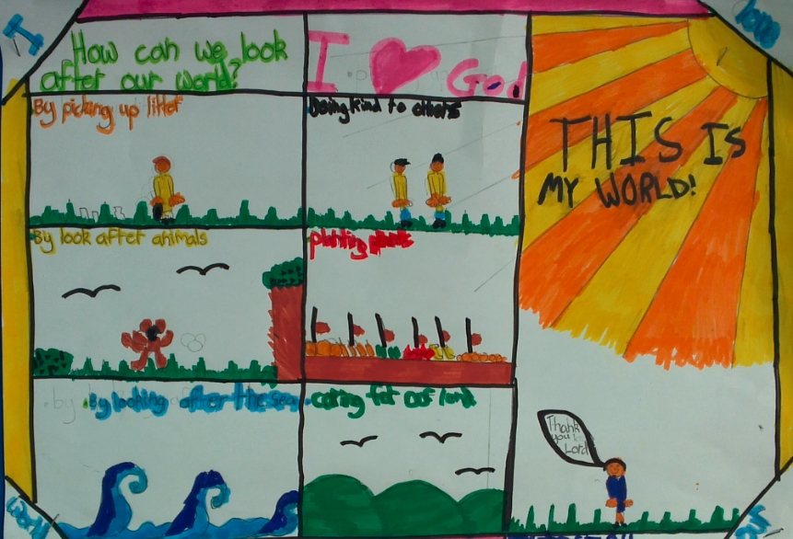
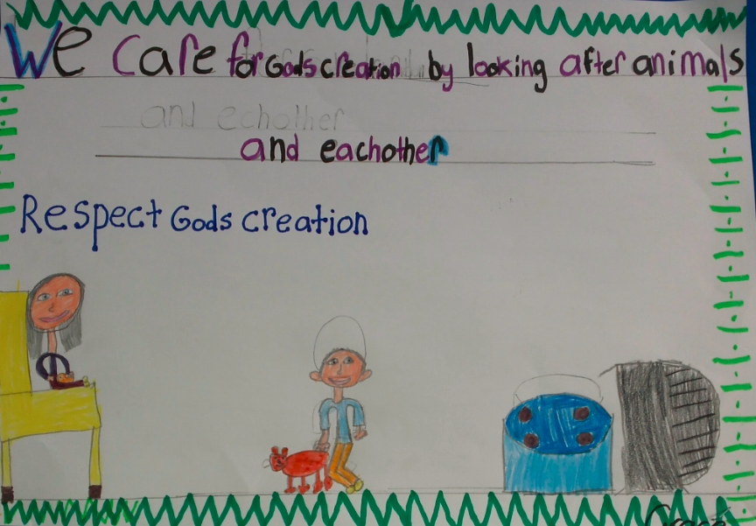
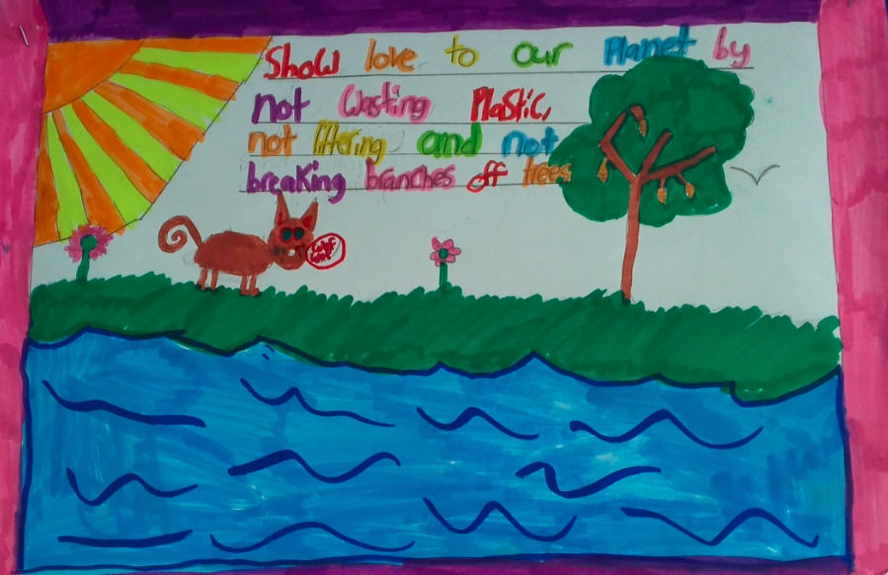
FURTHER POINTS FOR REFLECTION
Either alone or with a partner, identify the parts of the Theological Focus for the God strand that correspond with what Pope Francis is saying in this chapter.
Highlight words and phrases that you will remember personally when teaching this strand.
What do we want the children to be shaped by in this strand?
What lasting attitudes will you take from your teaching of the strand?
What links can be made with home and school for this strand?
What links can be made with the parish during this strand?
What links can be made with the community because of this learning?

Slide 17
Praised be You, my Lord, with all Your creatures, especially Sir Brother Sun, who is the day through whom You give us light. And he is beautiful and radiant with great splendour,
And bears a likeness of you, Most High.
Praised be You, my Lord, through Sister Moon and the stars, In heaven you formed them clear and precious and beautiful.
Praised be You, my Lord, through Brother Wind and through the Air, Cloudy and serene, and every kind of weather, through whom you give sustenance to your creatures.
Praised be You my Lord through Sister Water, Who is very useful and humble and precious and chaste.
Praised be You, my Lord, through Brother Fire, through whom You light the night and he is beautiful and playful and robust and strong. Amen.

Slide 18
