Slide 1
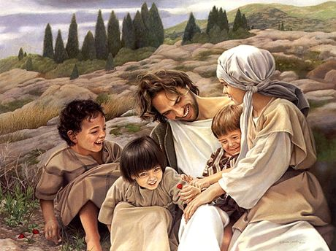
A Liturgy for Upper Primary
Returning to School
after the
Lockdown for Covid-19
May 2020

Slide 2
X 2

Slide 3
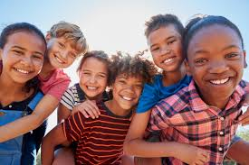
Smile

Slide 4
Response to opening prayers:
May its light
help us to remember
that you are here with us.

Slide 12
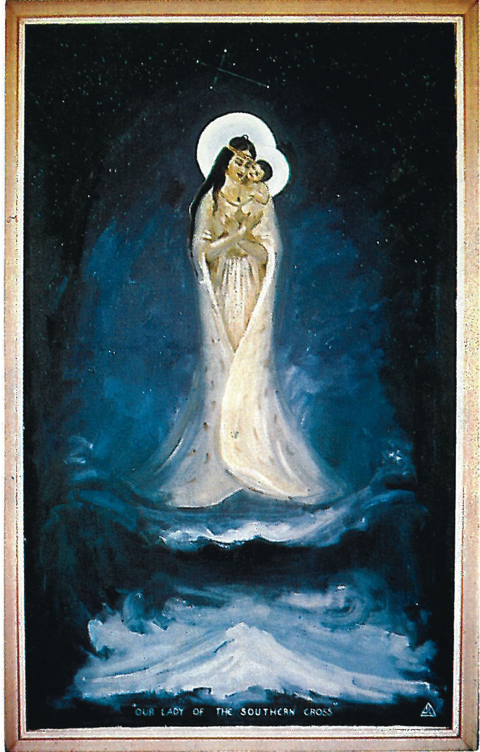
Ka waiata ki a Maria Hine i whakaae Whakameatia mai Te whare tangata
Hine purotu Hine ngākau Hine rangimārie
Ko te whaea Ko te whaea O te ao

