Slide 1
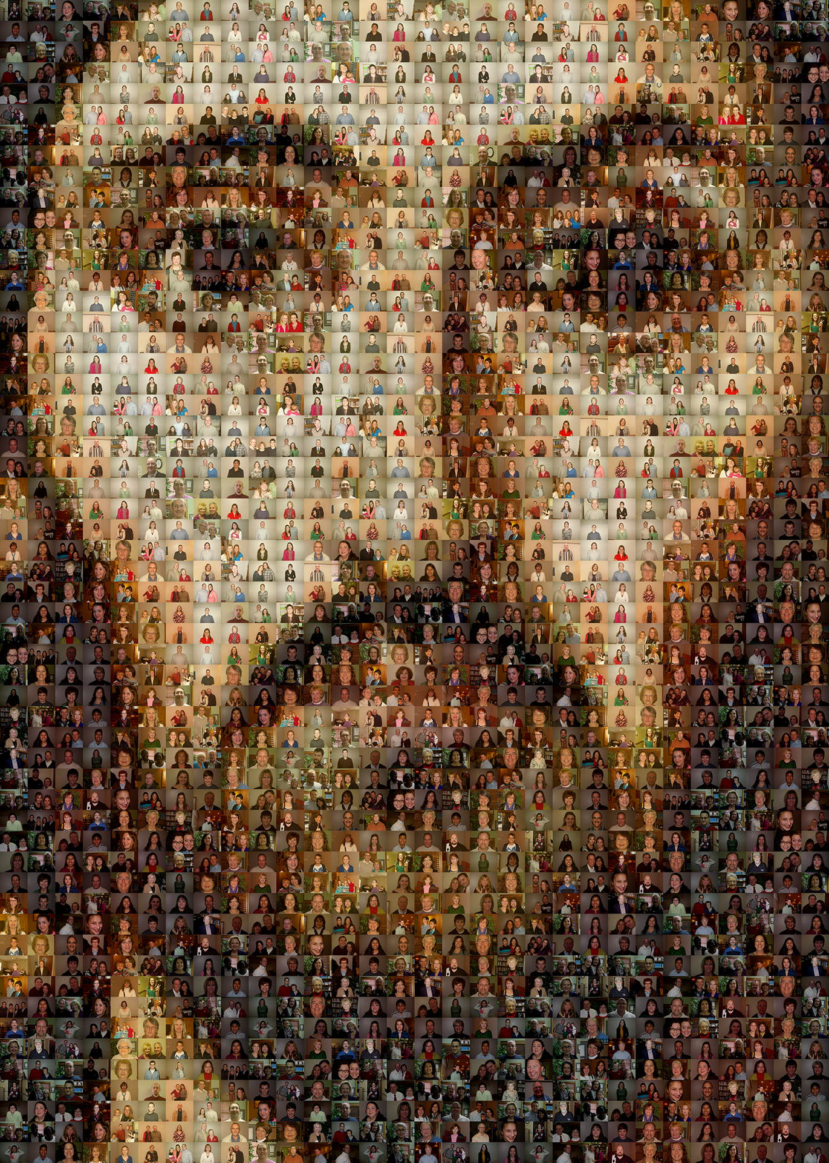
Staff
Coming Back Together
Diocese of Auckland.

Slide 2
As we gather together as a school community for the first time in a long while, let us take time to bring ourselves into the presence of God, our Creator, our Redeemer and the one who sustains us.
Let us stand to sing: Christ be our light.
Christ Be Our Light https://www.youtube.com/watch?v=5g0c4YeABTs

Slide 3
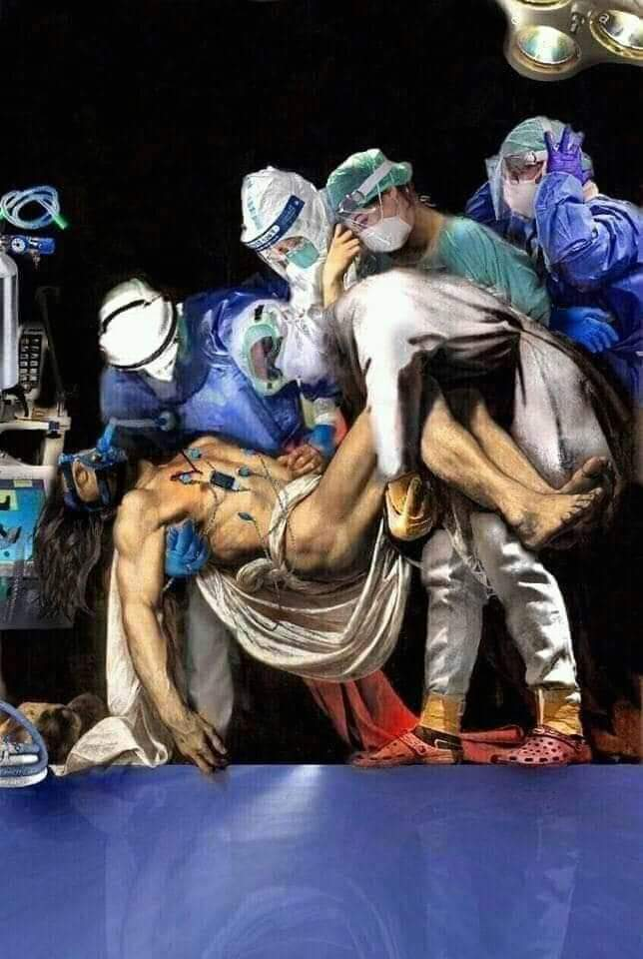
We begin In the name of the Father and of the Son
and of the Holy Spirit, Amen.
Lighting of the three candles:
The first candle is lit.
Loving God,
Creator, Protector, Healer
May this candle be a sign of your light.
May its light take away our darkness.
The second candle is lit.
Jesus, your Son walked our roads and lived with
us so that we might walk in your light.
May this candle be a sign of your light.
May its light take away our darkness.
Image from Facebook: Author unknown.

Slide 4
The third candle is lit.
And your Spirit is given to us,
as a light to guide our steps and
as a brightness of heart to signal welcome to all.
May this candle be a sign of your light.
May its light take away our darkness.
Father, Son and Holy Spirit, Three candles giving one light.
Our hearts have opened with the hopes we all have for the rest of the year
We bring these before you.
May the warmth and light of these flames remind us of your love and presence, Now and always.
Amen
Lighting of candles: adapted from Palmerston North Diocese United Prayer Resource 17.4.20

Slide 5
A adapted reading of the Beatitudes for in times of Pandemic……
Blessed are those….
The Word of God: Thanks be to God.
L smith License for none commercial use from Churchcartoons.com Dave Walker

Slide 6
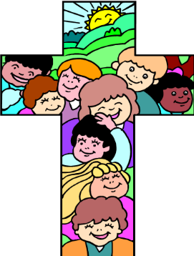
We pray….
For a sense of community, that we may retain in our living, loving, working, and playing a real empathy & concern for those whom and with whom we minister.
Give us, Creating God, a living sense of community.
For a spirit of honesty, that we may be able to recognise the truth of the situation & speak this truth in love to each other.
Give us, Redeeming God, a spirit of honesty.
For an ability to inspire, that we may be able to sustain
enthusiasm & create symbols of hope for our communities.
Give us, Spirit of God, your inspiration.

Slide 7
For a spirit of persistence, that we may preserve in our
efforts to empower & challenge each other.
Give us, God of Trinity, your love.
For those who have died during this COVID-19 pandemic give them peace & strength & courage to their families at this sad time.
Give us, God of the Resurrection, your strength.
If would like to name a person you would like us all to pray for, please do so now…..
We offer these prayers & the names of our loved ones to the protection of God: Amen

Slide 8
The Middle Time! (A short Reading; Author unknown)
Between the exhilaration of Beginning…
And the satisfaction of Concluding…
Is the Middle Time
Of Enduring… Changing…Trying… Despairing…
Continuing… & Becoming….
Jesus was the person of God’s Middle Time
Between Creation and Accomplishment.
Through Jesus God said of Creation,
“without mistake”.
And of Accomplishment,
“without doubt”.

Slide 9
And we in our Middle Times
Of wondering & waiting,
Hurrying & hesitating,
Regretting & revising –
We who have begun many things…
And have seen but few completed –
We who are becoming more & …less –
Through the evidence of God’s Middle Time
Have a stabilising hint
That we are not mistakes,
That we are irreplaceable,
That our Being is of interest,
And our Doing is of purpose,
That our Being and our Doing are surrounded by Amen.

Slide 10
Jesus is the Completer of unfinished people with unfinished work in unfinished times.
May Jesus keep us from sinking, from ceasing, from wasting, from solidifying.
That we may be for God,
Experimenters, Enablers, Encouragers
And Associates in Accomplishment!
Let us take a moment of silence to reflect upon
our renewed hope as move in to the future together.

Slide 11
As we end our prayer time, let us say together
God be with us and our teachers as we journey through these times
Hear our prayers
Hear our pleas
Hear our hopes
Hear our dreams
In the name of the Father
And of the Son
And of the Holy Spirit.
Amen.

Slide 12
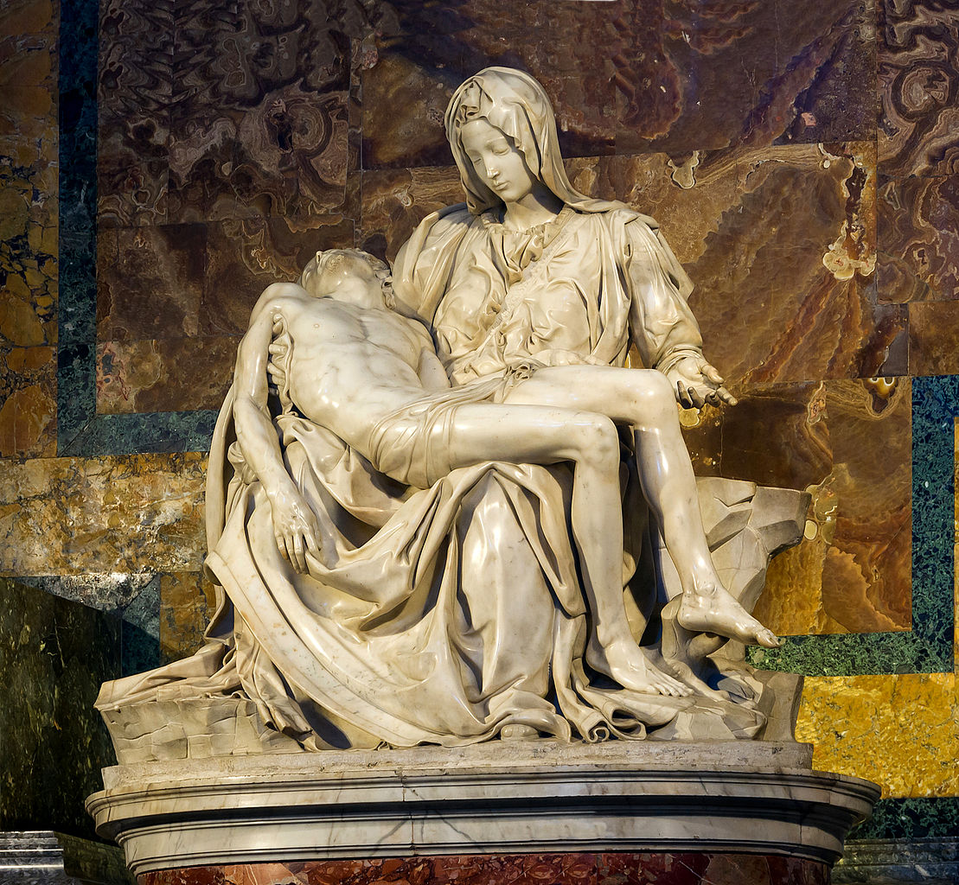
Let us all stand and sing: Mo Maria:
Mō Maria aianei
O tatou waiata
Kia kaha rā tātou
Kia nui te aroha
Tenā hoki ngā ahere E whakahonore ana Ki to ratou rehina Ki a Maria anō rā
Mō Maria aianei
O tatou waiata
Kia kaha rā tātou
Kia nui te aroha
Amene
The "Pietà" by Michelangelo, Saint-Peter's Basilica, Vatican City: Wikicommons.

