Slide 1
Note to musicians and liturgy committees.
You are welcome to use this power point as it is, or change parts of it so your community can participate more fully in it.
Please check this power point carefully before you use it to ensure all the sung parts are as you want them to be.
The music suggestions for this Mass have been listed on the liturgy / music web page. This power point correlates with those suggestions.
The psalm refrain provided can be found on the webs page Auckland Diocese / Liturgy / Music. It can be used freely.
prepare for missionary discipleship
strengthen spirituality of young people
care for poor
Diocese of Auckland

Slide 2
Diocese of Auckland
To prepare all people for missionary discipleship
To strengthen the spirituality of young people
To care for poor

Slide 3
Awake from your slumber!
Arise from your sleep! A new day is dawning
For all those who weep. The people in darkness
Have seen a great light. The Lord of our longing
Has conquered the night.
City of God by Dan Schutte © 1992 Willow Publications All rights reserved. Used with permission. Onelicense A-
prepare for missionary discipleship
strengthen spirituality of young people
care for poor
Diocese of Auckland

Slide 4
Let us build the city of God. May our tears be turned into dancing. For the Lord our light and our love
Has turned the night into day.
prepare for missionary discipleship
strengthen spirituality of young people
care for poor
Diocese of Auckland

Slide 5
We are sons of the morning;
We are daughters of day. The One who has loved us
Has brightened our way. The Lord of all kindness
Has called us to be A light for all people
To set their hearts free.
prepare for missionary discipleship
strengthen spirituality of young people
care for poor
Diocese of Auckland

Slide 6
Let us build the city of God. May our tears be turned into dancing. For the Lord our light and our love
Has turned the night into day.
prepare for missionary discipleship
strengthen spirituality of young people
care for poor
Diocese of Auckland

Slide 7
Singing pauses while the Advent candle is lit.
prepare for missionary discipleship
strengthen spirituality of young people
care for poor
Diocese of Auckland

Slide 8
O city of gladness
now lift up your voice, proclaim the good tidings
that all may rejoice
Let us build the city of God. May our tears be turned into dancing. For the Lord our light and our love
Has turned the night into day.
prepare for missionary discipleship
strengthen spirituality of young people
care for poor
Diocese of Auckland

Slide 9
prepare for missionary discipleship
strengthen spirituality of young people
care for poor
Diocese of Auckland

Slide 10
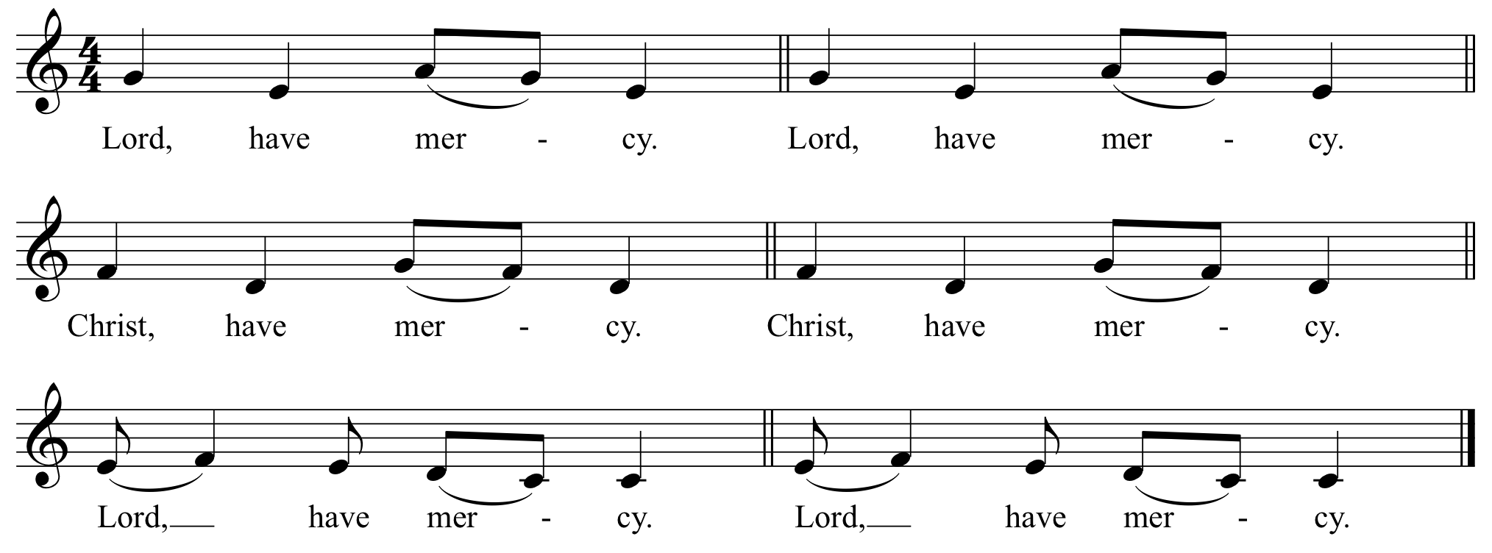
Hopetoun Mass – Lord have mercy © 2011 PD Used with permission.
prepare for missionary discipleship
strengthen spirituality of young people
care for poor
Diocese of Auckland

Slide 11
prepare for missionary discipleship
strengthen spirituality of young people
care for poor
Diocese of Auckland

Slide 12
prepare for missionary discipleship
strengthen spirituality of young people
care for poor
Diocese of Auckland

Slide 13
prepare for missionary discipleship
strengthen spirituality of young people
care for poor
Diocese of Auckland

Slide 14
prepare for missionary discipleship
strengthen spirituality of young people
care for poor
Diocese of Auckland

Slide 15
prepare for missionary discipleship
strengthen spirituality of young people
care for poor
Diocese of Auckland

Slide 16
After the Gospel
Priest: Ko te rongopai a te Ariki The Gospel of the Lord.
People: Kia whakanuia ra koe (praise to you) e te Ariki (Lord) e Hehu Karaiti (Jesus Christ) Praise to you Lord Jesus Christ
prepare for missionary discipleship
strengthen spirituality of young people
care for poor
Diocese of Auckland

Slide 17
prepare for missionary discipleship
strengthen spirituality of young people
care for poor
Diocese of Auckland

Slide 18
I believe in God,
the Father almighty,
Creator of heaven and earth,
and in Jesus Christ,
his only Son, our Lord,
(We all bow for the following words until “the Virgin Mary”.)
who was conceived by the Holy Spirit,
born of the Virgin Mary,
suffered under Pontius Pilate,
was crucified, died and was buried;
he descended into hell;
prepare for missionary discipleship
strengthen spirituality of young people
care for poor
Diocese of Auckland

Slide 19
on the third day
he rose again from the dead;
he ascended into heaven,
and is seated at the right hand of God the Father almighty;
from there he will come to judge the
living and the dead.
prepare for missionary discipleship
strengthen spirituality of young people
care for poor
Diocese of Auckland

Slide 20
I believe in the Holy Spirit,
the holy catholic Church,
the communion of saints,
the forgiveness of sins,
the resurrection of the body,
and life everlasting.
Amen.
prepare for missionary discipleship
strengthen spirituality of young people
care for poor
Diocese of Auckland

Slide 21
prepare for missionary discipleship
strengthen spirituality of young people
care for poor
Diocese of Auckland

Slide 22
Response to the prayer of the faithful
prepare for missionary discipleship
strengthen spirituality of young people
care for poor
Diocese of Auckland

Slide 23
prepare for missionary discipleship
strengthen spirituality of young people
care for poor
Diocese of Auckland

Slide 24
You are salt for the Earth O people
Salt for the Kingdom of God!
Share the flavour of life O people:
Life in the Kingdom of God.
Bring forth the Kingdom of mercy,
Bring forth the Kingdom of peace;
Bring forth the Kingdom of justice,
Bring forth the city of God.
Bring Forth The Kingdom by Marty Haugen © 1986 GIA Publications All rights reserved. Used with permission. Onelicense A -
prepare for missionary discipleship
strengthen spirituality of young people
care for poor
Diocese of Auckland

Slide 25
You are a light on a hill O people:
Light for the city of God!
Shine so holy and bright O people
Shine for the Kingdom of God.
Bring forth the Kingdom of mercy,
Bring forth the Kingdom of peace;
Bring forth the Kingdom of justice,
Bring forth the city of God.
prepare for missionary discipleship
strengthen spirituality of young people
care for poor
Diocese of Auckland

Slide 26
You are a seed of the Word O people;
Bring forth the Kingdom of God!
Seeds of mercy and seeds of justice,
Grow in the Kingdom of God!
Bring forth the kingdom of mercy,
Bring forth the Kingdom of peace;
Bring forth the Kingdom of justice,
Bring forth the city of God.
prepare for missionary discipleship
strengthen spirituality of young people
care for poor
Diocese of Auckland

Slide 27
We are a blest and a pilgrim people:
Bound for the Kingdom of God!
Love our journey and love our homeland:
Love is the kingdom of God.
Bring forth the kingdom of mercy,
Bring forth the Kingdom of peace;
Bring forth the Kingdom of justice,
Bring forth the city of God.
prepare for missionary discipleship
strengthen spirituality of young people
care for poor
Diocese of Auckland

Slide 28
prepare for missionary discipleship
strengthen spirituality of young people
care for poor
Diocese of Auckland

Slide 29
prepare for missionary discipleship
strengthen spirituality of young people
care for poor
Diocese of Auckland

Slide 30
prepare for missionary discipleship
strengthen spirituality of young people
care for poor
Diocese of Auckland

Slide 31
Holy, Holy, Holy Lord God of hosts.
Heaven and earth are full of your glory.
Hosanna in the highest.
Blessed is he who comes in the
name of the Lord.
Hosanna in the highest.
Hopetoun Mass – Lord have mercy © 2011 PD Used with permission.
prepare for missionary discipleship
strengthen spirituality of young people
care for poor
Diocese of Auckland

Slide 32
prepare for missionary discipleship
strengthen spirituality of young people
care for poor
Diocese of Auckland

Slide 33
prepare for missionary discipleship
strengthen spirituality of young people
care for poor
Diocese of Auckland

Slide 34
prepare for missionary discipleship
strengthen spirituality of young people
care for poor
Diocese of Auckland

Slide 35
prepare for missionary discipleship
strengthen spirituality of young people
care for poor
Diocese of Auckland

Slide 36
prepare for missionary discipleship
strengthen spirituality of young people
care for poor
Diocese of Auckland

Slide 37
Lamb of God, you take away the sins
of the world, have mercy on us.
Lamb of God, you take away the sins
of the world, have mercy on us.
Lamb of God, you take away the sins
of the world, grant us peace.
prepare for missionary discipleship
strengthen spirituality of young people
care for poor
Diocese of Auckland

Slide 38
prepare for missionary discipleship
strengthen spirituality of young people
care for poor
Diocese of Auckland

Slide 39
Mary heard a voice calling out her name.
Mary said ‘how can this be?’
Mary made a choice with an open heart.
What will your answer be?
What will our answer be?
Let love and peace be born in us.
Do not be afraid!
Trust in the mystery of God’s life
Be born in us today.
Jesus you are The Way.
God’s Call by Fiona Dyball © 2018 Liturgical Song Publications All rights reserved. Used with permission. Onelicense A-
prepare for missionary discipleship
strengthen spirituality of young people
care for poor
Diocese of Auckland

Slide 40
May it be according to God’s word.
All is possible with god.
Servants of the lord bring open hands
To receive and to give God’s life.
We receive and we give God’s life.
Let love and peace be born in us.
Do not be afraid!
Trust in the mystery of God’s life
Be born in us today.
Jesus you are The Way.
prepare for missionary discipleship
strengthen spirituality of young people
care for poor
Diocese of Auckland

Slide 41
When we hear love’s voice
calling out our name,
Will we listen to God’s call?
Faith and hope and love these three remain
And the greatest of these is love
And the greatest of these is love.
Let love and peace be born in us.
Do not be afraid!
Trust in the mystery of God’s life
Be born in us today. Jesus you are The Way.
prepare for missionary discipleship
strengthen spirituality of young people
care for poor
Diocese of Auckland

Slide 42
prepare for missionary discipleship
strengthen spirituality of young people
care for poor
Diocese of Auckland

Slide 43
Te Aroha
Te whakapono
Me te Rangimarie
Tatou tatou e.
Repeat
Love
Faith
Peace
For everyone.
Te Aroha Public domain composer unknown
prepare for missionary discipleship
strengthen spirituality of young people
care for poor
Diocese of Auckland

Slide 44
prepare for missionary discipleship
strengthen spirituality of young people
care for poor
Diocese of Auckland

