Slide 1
Preparation Slide - YouTube links in this PowerPoint (note: all links are optional. If you choose to use songs, include them in your regular parish copyright reporting.)
Open any links you want to use - have them on your desktop before beginning.
In preparation, let video play to the end of the advertisement (if there is an advertisement).
Slide 4 | →→ Kids Lord Jesus Come →→ Youth O come o Come Emmanuel →→ Adults O Come o come Emmanuel | https://www.youtube.com/watch?v=3wFE0muUzw8 https://www.youtube.com/watch?v=UH7asSGxAxA https://www.youtube.com/watch?v=7xtpJ4Q_Q-4
Slide 5 | Gloria | https://www.youtube.com/watch?v=8qjesHLjkio
Slide 9 | Psalm – Kids – Psalm --Youth – Psalm --Adults | https://www.youtube.com/watch?v=eyAvslNWgQQ https://www.youtube.com/watch?v=PGqzHnY7GbE https://www.youtube.com/watch?v=slcq7aCBATg
Slide 11 | Kids Gospel – Catholic Kids Media Advent 3C | https://www.youtube.com/watch?v=-6OeD4sj9Pk
Slide 13 | Te Reo Māori The Lord’s Prayer | https://www.aucklandcatholic.org.nz/liturgy-prayer/te-reo-in-the-liturgy/ Scroll down and open the button – ko to inoi a te Ariki
Slide 14 | Laudato si Action Platform – Building Teams | https://www.youtube.com/watch?v=J8Kz_poR55E
Slide 17 | Dismissal Kids Joyful Joyful we Adore Thee Youth Joyful Joyful we Adore Thee Adults Joyful Joyful we Adore Thee | https://www.youtube.com/watch?v=kX5zbJswRo8&t=45s https://www.youtube.com/watch?v=iJOj9umiMjs https://www.youtube.com/watch?v=W0uoGU0YBxo
Notes:
Just before beginning the prayer, ask people to mute their microphones. Not all people will know how to do this – some guidance may be needed.

Slide 2
Tips for making the most of Advent
Let this Advent season speak to you and your family of joy and hope.
Create a space to be together for a few minutes every day.
Tip – don’t make this a long or onerous time. You want family to enjoy coming and
eager to come again.
Prepare - You could prepare an Advent prayer focus with some evergreen leaves and a candle. Purple candle if you can find one. If you want to add flowers, there is lots of lavender in flower at this time of year.
Gather - When you have gathered together, light a candle, and sign the cross.
Listen - Someone reads a reading from the day OR even just a single verse, chosen beforehand. It doesn’t need to be long.
Respond - Then give everyone a chance to respond. Accept whatever is offered.
Bless – Thank all for taking part and offer a blessing; it could be good to use words from the scripture you have heard; e.g. may you be filled with joy and may your love increase ever-more, through Christ we pray. Amen
Finally – a treat. You could open a day on the Advent calendar – and maybe find a treat there. Or follow-up with more family time: stories or a family game.
Extra – this is a helpful little video explaining Advent https://www.youtube.com/watch?v=eC0FGQLBp7w

Slide 3
Welcome
Invitation to Everyone - Light the candle on your prayer focus.
(Do this deliberately as part of your prayer. Candles remind us of the presence of Christ the light.)
Notes:
Just before beginning the prayer, ask people to mute their microphones. Not all people will know how to do this – some guidance may be needed.

Slide 4
SIGN OF THE CROSS: Ki te ingoa…
Tēnā Koutou Katoa – Haere mai. Welcome everyone. This is the third Sunday of Advent, Year C. Today has a special name because it is marked as a Sunday of joy – Gaudete Sunday. We are invited to be joyful because in our midst is the Holy one who rejoices and delights over each of us. What a great thought that is – God rejoices over us. Let’s sing.
Let’s sing
→→ Kids Lord Jesus Come https://www.youtube.com/watch?v=3wFE0muUzw8
→→ Youth O come o Come Emmanuel https://www.youtube.com/watch?v=UH7asSGxAxA
→→ Adults O Come o come Emmanuel https://www.youtube.com/watch?v=7xtpJ4Q_Q-4
Feedback to Auckland Diocese by 22/4/2022

Slide 5
READER: READER: E te Atua, God with us, by your grace, may we share what we have, be always grateful so we are not tempted to complain and may we seek to do what is right.
You call a people to yourself Lord have mercy (All) Lord have mercy
You turn enemies away Christ have mercy (All)Christ have mercy
You lift up the broken-hearted Lord have mercy (All) Lord have mercy
Gloria (optional) – Mass of Joy and Peace https://www.youtube.com/watch?v=8qjesHLjkio
Feedback to Auckland Diocese by 22/4/2022

Slide 6
Reader: Laudato si Action Platform
Today, John the Baptist calls us to do what is right. Pope Francis calls us to the righteous action of embracing the Laudato si Action Platform. The first year of the Laudato Si Action Platform is dedicated to building community. How do we build community?
In his book, A Guide to Building Teams for Catholic Parishes, Patrick Lencioni says …
“ The true measure of a team is that it accomplishes the results that it sets out to achieve,” and the first big building block for teams is trust.
Discuss – As a parish, what is it we are setting out to achieve?
As a parish,
is there something
we want to
set out to achieve?
Feedback to Auckland Diocese by 22/4/2022

Slide 7
COLLECT/OPENING PRAYER: In this time of silence, we bring to mind all the things we want to pray for. (Allow silence, 1 minute)
O gracious God, we your people await with joy the Feast of the Lord’s nativity. Stir in us a holy longing for Christ, who comes to us with great humility. We make this prayer through our Lord Jesus Christ, who lives and reigns with you in the unity of the Holy Spirit, one God, forever and ever.
ALL: Amen
Feedback to Auckland Diocese by 22/4/2022

Slide 8
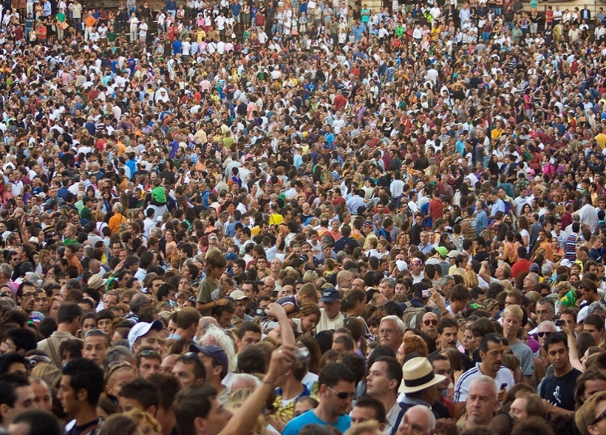
Zephaniah 3:14-18
After the reading, silence
Let’s be quiet for a few moments and let
God’s Word find a place to rest inside us.
Discussion - What does, ‘the Lord your God is in your midst’ mean to me, to us, today?
The Lord, your God,
is in your midst …
Crowd Guzmán Lozano CC
Notes:
FIRST READING: Zephaniah 3:14-18
Shout for joy, O daughter Zion! Sing joyfully, O Israel! Be glad and exult with all your heart, O daughter Jerusalem! The Lord has removed the judgment against you he has turned away your enemies; the King of Israel, the Lord, is in your midst, you have no further misfortune to fear. On that day, it shall be said to Jerusalem: Fear not, O Zion, be not discouraged! The Lord, your God, is in your midst, a mighty saviour; he will rejoice over you with gladness, and renew you in his love, he will sing joyfully because of you, as one sings at festivals.
Ko te kupu a te Ariki - The Word of the Lord.
ALL: Whakamoemiti ki te Atua - Thanks be to God
Silence – Let’s be quiet for a few moments and let God’s Word find a place to rest inside us.
Discussion - What place does joy have in our lives?

Slide 9
PSALM: Isaiah 12 Cry out with joy and gladness
Kids https://www.youtube.com/watch?v=eyAvslNWgQQ
Youth https://www.youtube.com/watch?v=PGqzHnY7GbE
Adults https://www.youtube.com/watch?v=slcq7aCBATg
OR – say together
Cry out with joy and gladness: for among you is the great and Holy One of Israel.
God indeed is my saviour; I am confident and unafraid. My strength and my courage is the Lord, and he has been my saviour. With joy you will draw water at the fountain of salvation. Give thanks to the Lord, acclaim his name; among the nations make known his deeds, proclaim how exalted is his name. Sing praise to the LORD for his glorious achievement; let this be known throughout all the earth. Shout with exultation, O city of Zion, for great in your midst is the Holy One of Israel!
Cry out with joy and gladness: for among you is the great and Holy One of Israel.
Notes:
Pause at the end of each line and wait for everyone to be in the same place.

Slide 10
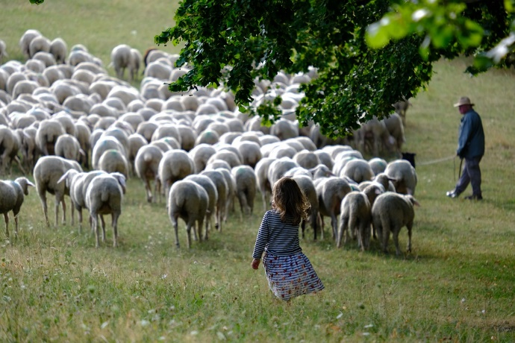
SECOND READING:
Philippians 4:4-7
Follow the reading with quiet thinking time
Discussion - Which words from this text touch me most strongly?
Your kindness should
be
known
to
all
Free for use attribution not required
Notes:
Second Reading Philippians 1:4-6, 8-11
A reading from the book of Philippians
Brothers and sisters Rejoice in the Lord always. I shall say it again: rejoice! Your kindness should be known to all. The Lord is near. Have no anxiety at all, but in everything, by prayer and petition, with thanksgiving, make your requests known to God.
Then the peace of God that surpasses all understanding will guard your hearts and minds in Christ Jesus.
Ko te kupu a te Ariki - The Word of the Lord
ALL: Whakamoemiti ki te Atua - Thanks be to God
Silence -Follow the reading with quiet thinking time.
Discussion - Which words from this text touch me most strongly.

Slide 11
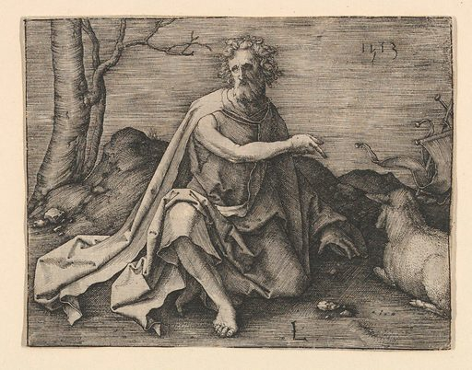
The crowds asked John the Baptist, “What should we do?”
GOSPEL: Luke 3:10-18
Reader: Kia noho te Ariki - The Lord be with you
All: Ki tōu wairua anō hoki - And also with you
Reader: (At the end of the reading)
Ko te rongopai a te Ariki –
The Gospel of the Lord.
ALL: Kia whakanuia rā koe, e te Ariki, e Hēhu Karaiti Praise to you Lord Jesus Christ.
Follow the reading with silence
St John the Baptist in the desert Lucas van Leyden - Metropolitan Museum of art
→→ Kids Homily– Catholic Kids Media Advent 3C - https://www.youtube.com/watch?v=-6OeD4sj9Pk
Discuss: what was john the Baptist’s message?
→→ Adults / Youth - Homily / Discussion – What types of things did John the Baptist tell people to do?
Notes:
GOSPEL: Luke 3:10-18
Reader Kia noho te Ariki - The Lord be with you
All: Ki tōu wairua anō hoki - And also with you
A reading from the Gospel of Luke.
The crowds asked John the Baptist, “What should we do?” He said to them in reply, “Whoever has two cloaks should share with the person who has none. And whoever has food should do likewise.” Even tax collectors came to be baptized and they said to him, “Teacher, what should we do?” He answered them, “Stop collecting more than what is prescribed.” Soldiers also asked him, “And what is it that we should do?” He told them, “Do not practice extortion, do not falsely accuse anyone, and be satisfied with your wages.”
Now the people were filled with expectation,
and all were asking in their hearts whether John might be the Christ. John answered them all, saying, “I am baptizing you with water, but one mightier than I is coming. I am not worthy to loosen the thongs of his sandals. He will baptize you with the Holy Spirit and fire. His winnowing fan is in his hand to clear his threshing floor and to gather the wheat into his barn, but the chaff he will burn with unquenchable fire.” Exhorting them in many other ways, he preached good news to the people.
Reader Ko te rongopai a te Ariki - The Gospel of the Lord.
ALL: Kia whakanuia rā koe, e te Ariki, e Hēhu Karaiti - Praise to you Lord Jesus Christ.
After the reading -. Silence.
Think about the reading - Let some words repeat in your mind.
→→ Kids Homily– Catholic Kids Media Advent 3C - https://www.youtube.com/watch?v=-6OeD4sj9Pk
Discuss: what was john the Baptist’s message?
→→ Adults / Youth - Homily / Discussion – What types of things did John the Baptist tell people to do?

Slide 12
Prayer of the Faithful: As God’s people we pray for the needs of the whole world.
For the Church – that we give away what we don’t need, show kindness and act justly in all we do.
(Silence) Reader: E te Ariki All: whakarongo mai rā ki a mātou
For national and international leaders – that leaders will unite to provide vaccination and care for refugees and people in poor nations.
(Silence) Reader: E te Ariki All: whakarongo mai rā ki a mātou
For Aotearoa New Zealand – that as our country opens up in new alert levels, people will be attentive to the needs and fears of others, act with kindness, and follow health guidelines.
(Silence) Reader: E te Ariki All: whakarongo mai rā ki a mātou
For people who are jobless or struggle to make ends meet - that kindness will excel in our communities and those who are vulnerable will experience understanding, support, love.
(Silence) Reader: E te Ariki All: whakarongo mai rā ki a mātou
For people burdened by guilt or failure – that they will come to experience the joy of knowing that God rejoices over them with gladness, and removes all judgement against them.
(Silence) Reader: E te Ariki All: whakarongo mai rā ki a mātou
For ourselves – that we live with a sense of joy, knowing that God, Emmanuel, is present in our midst.
(Silence) Reader: E te Ariki All: whakarongo mai rā ki a mātou
Other Petitions
Concluding Prayer:
God of goodness and life, you call us to sing joyfully, to be glad and exult with all our heart, for you have removed all judgement against us and turned our enemies away. You are steadfast in our midst: you rejoice over us. By your grace, may we trust in your goodness. We ask this through Christ our Lord… Amen.

Slide 13
THE LORD’S PRAYER:
We pray the prayer Jesus gave us.
The Lord’s Prayer in Māori at this link https://www.aucklandcatholic.org.nz/liturgy-prayer/te-reo-in-the-liturgy/
Feedback to Auckland Diocese by 22/4/2022

Slide 14
READER – The Laudato Si Action Platform - taking action
The Laudato si Action Platform is calls us to build community. Building community is partly about building teamwork.
This short video has something to say about teamwork. Spend 4 minutes watching it. https://www.youtube.com/watch?v=J8Kz_poR55E (Teamwork / Igniter Media / Church ministry)

Slide 15
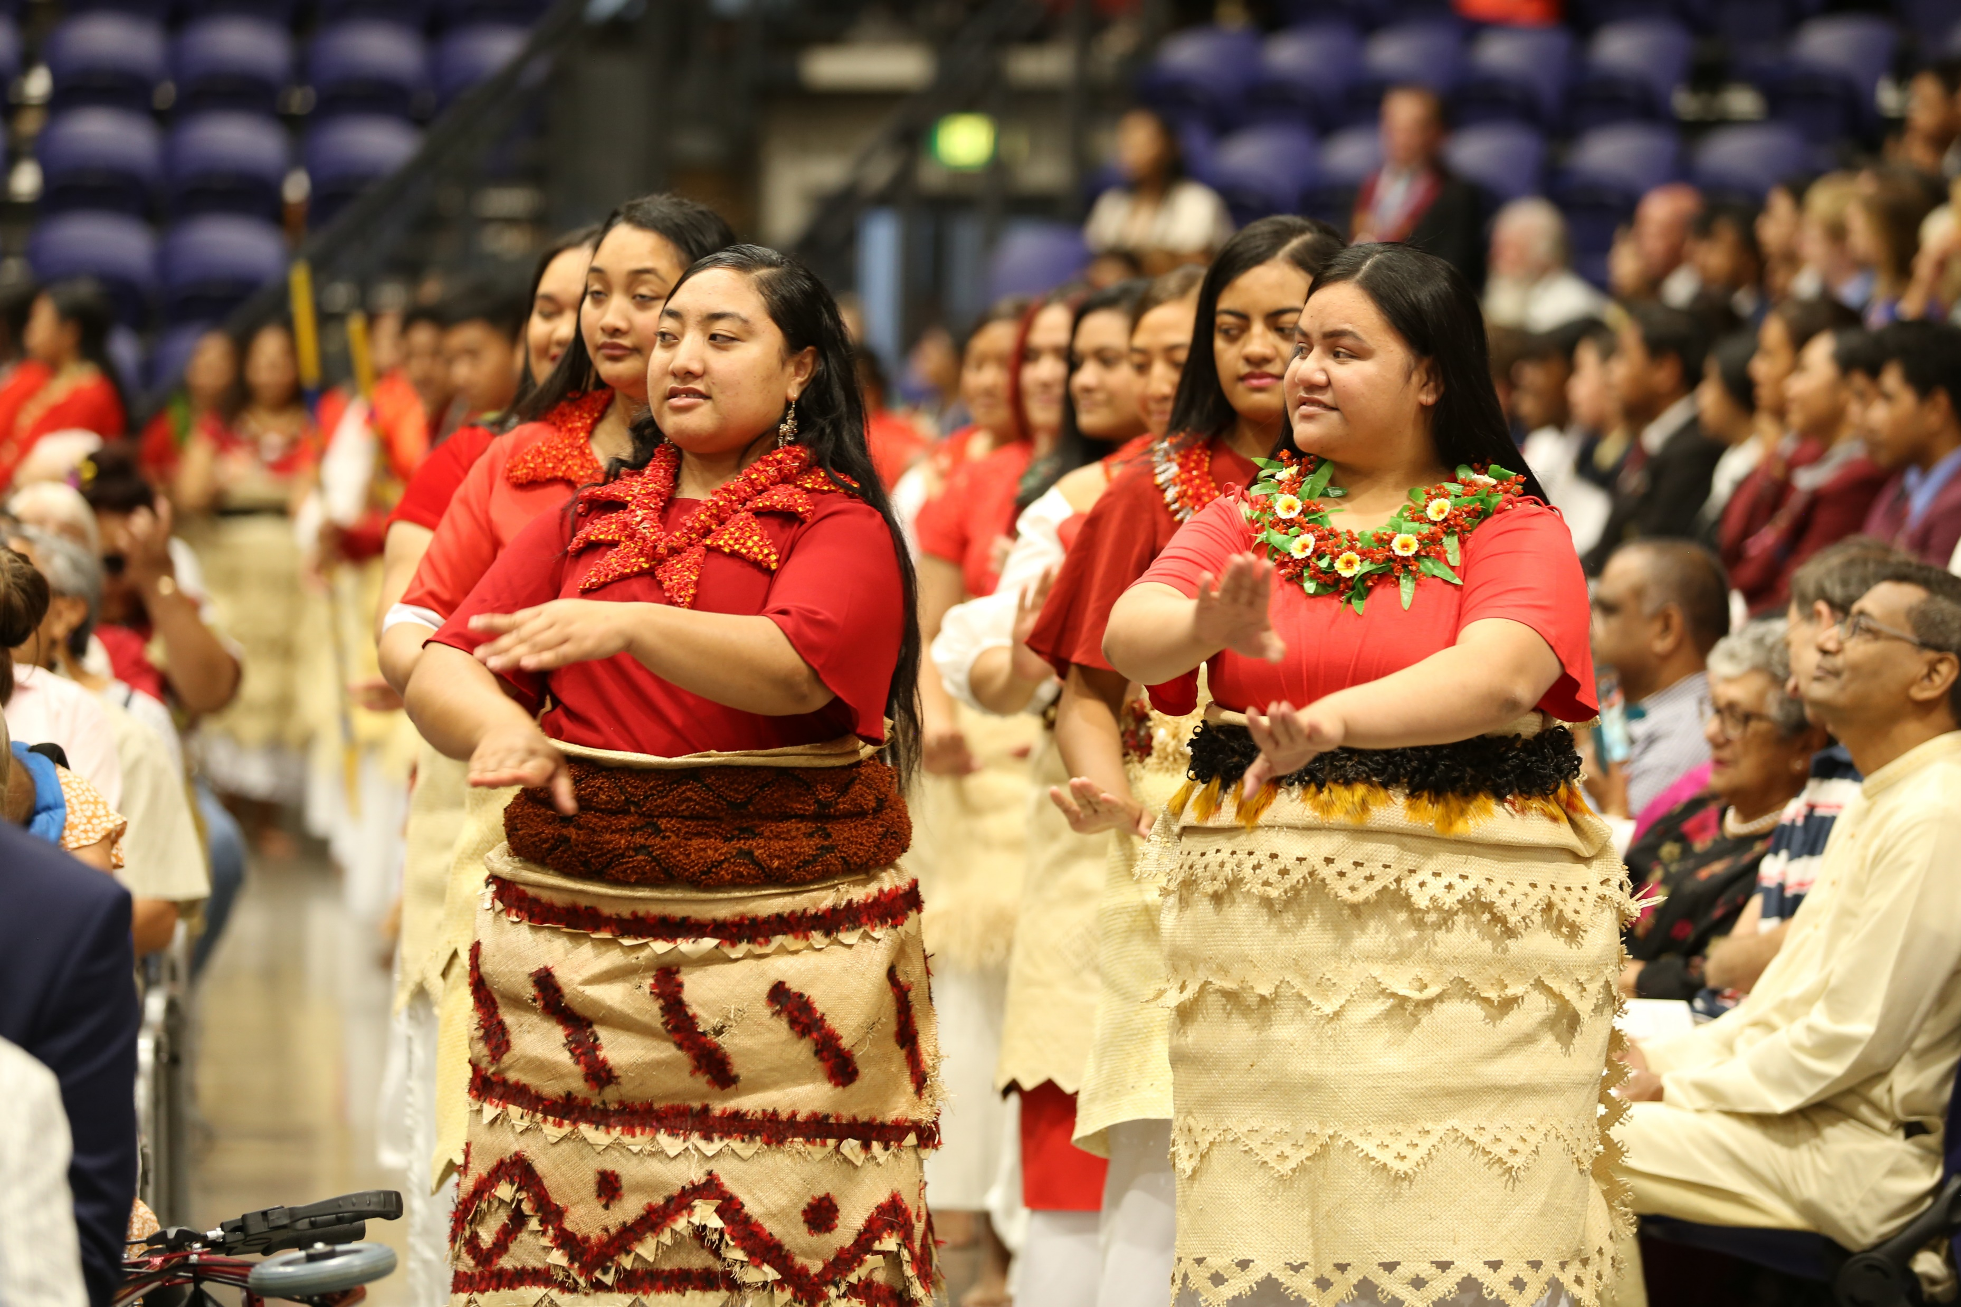
- build community -
Reader - Taking Action
The Laudato Si Action Platform
Discussion: What is the message about teamwork? How well do groups in my parish work as a team?
Feedback to Auckland Diocese by 22/4/2022

Slide 16
Reader. It is Advent, Week 3. Continue to celebrate Advent in your homes. Light an Advent candle (or three candles) on your wreath each day,– as you do so, invite Christ to be present in your day. Let’s journey towards Christmas with a sense of joy, preparing as we can with acts of kindness, by prayer and by fasting from excess.
Notes:
Just before beginning the prayer, ask people to mute their microphones. Not all people will know how to do this – some guidance may be needed.

Slide 17
Reader. Thank you for your kindness. Thank you for your participation.
Kia tau te rangimārie ki a koutou – Peace be with you.
Let us go in peace, loving and serving God by
caring for our planet and for one another.
All: Thanks be to God.
SONG:
Kids Joyful Joyful we Adore Thee https://www.youtube.com/watch?v=kX5zbJswRo8&t=45s
Youth Joyful Joyful we Adore Thee https://www.youtube.com/watch?v=iJOj9umiMjs
Adults Joyful Joyful we Adore Thee https://www.youtube.com/watch?v=W0uoGU0YBxo
Feedback to Auckland Diocese by 22/4/2022

Slide 18
Tips for making the most of Advent
Let this Advent season speak to you and your family of joy and hope.
Create a space to be together for a few minutes every day.
Tip – don’t make this a long or onerous time. You want family to enjoy coming and
eager to come again.
Prepare - You could prepare an Advent prayer focus with some evergreen leaves and a candle. Purple candle if you can find one. If you want to add flowers, there is lots of lavender in flower at this time of year.
Gather - When you have gathered together, light a candle, and sign the cross.
Listen - Someone reads a reading from the day OR even just a single verse, chosen beforehand. It doesn’t need to be long.
Respond - Then give everyone a chance to respond. Accept whatever is offered.
Bless – Thank all for taking part and offer a blessing; it could be good to use words from the scripture you have heard; e.g. may you be filled with joy and may your love increase ever-more, through Christ we pray. Amen
Finally – a treat. You could open a day on the Advent calendar – and maybe find a treat there. Or follow-up with more family time: stories or a family game.
Extra – this is a helpful little video explaining Advent https://www.youtube.com/watch?v=eC0FGQLBp7w

Slide 19
Link to Diocesan Synod information
The Diocese of Auckland: for more information on what the Synod is
and how to participate. https://www.aucklandcatholic.org.nz/synod/
Printable PDF, with Synod information https://www.aucklandcatholic.org.nz/wp-content/uploads/2021/10/SynodInformationBooklet.pdf
Feedback to Auckland Diocese by 22/4/2022

